Slide 1
How to Build an Industry Cost Profile (ICP) for a product in Poland
Gather Manufacturing and Industry data
Step 2
Summarize the Data for Industry of interest.
Step 3
Calculate Ratios & build the Industry Cost Profile
Step 1

Slide 2
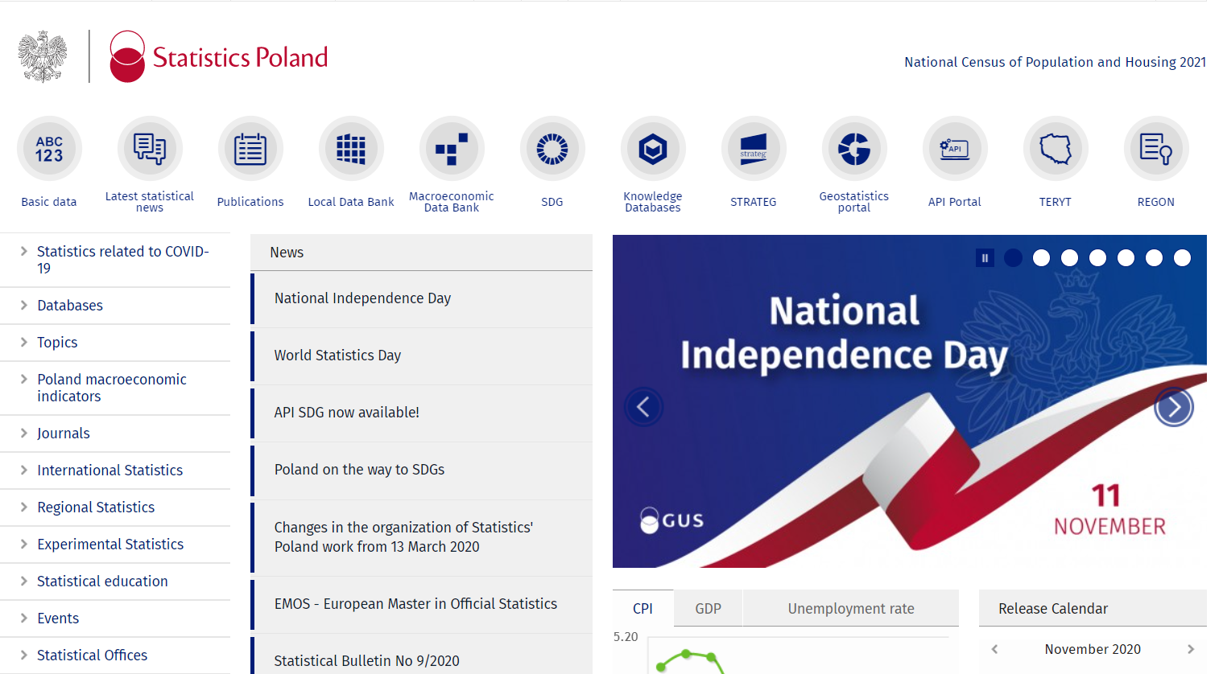
Gather Manufacturing and Industry data
Gather Manufacturing and Industry data
Step 1
Step 1
Go to Central Statistical Office website of Poland :
Click on “Publications”
http://stat.gov.pl/en/

Slide 3
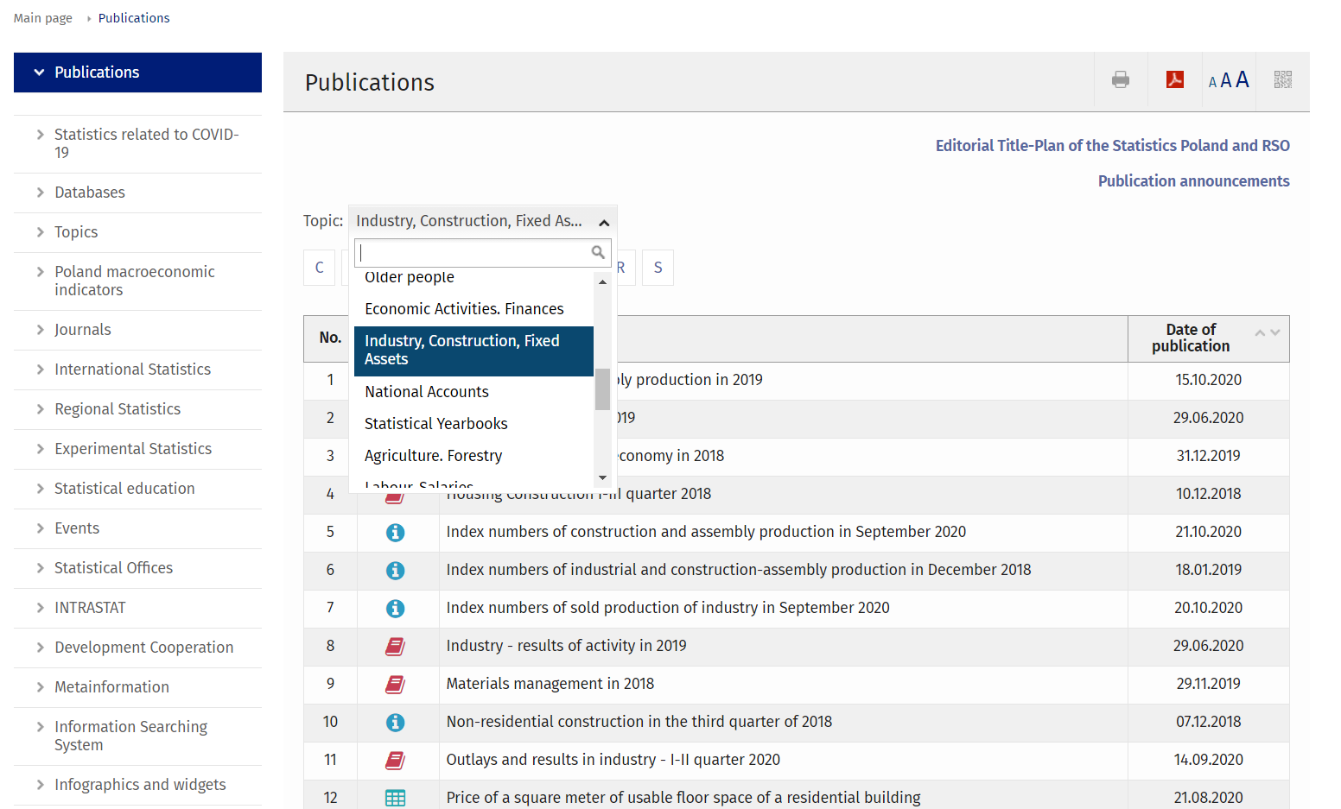
Step 1
Gather Manufacturing and Industry data
Select “Industry, Construction, Fixed Assets”.
Then select “Outlays and Results” for the latest time period available.
e.g. – “Outlays and results in I-II quarter 2020”

Slide 4
Step 1
Gather Manufacturing and Industry data
Download/Open Excel file
Tip: the previous year manufacturing & industry data can be found in “Archive” folder

Slide 5
Step 1
Gather Manufacturing and Industry data
Within the excel file, in the list of tables look for the table reflecting “Revenues (of which export), costs and financial result from the sale of products, goods and materials in industry by sections and divisions”
Look for industry of interest (Manufacture of rubber and plastic products) & record figures for:
- Net sales revenues of products, goods and materials
- Cost of products sold goods and materials

Slide 6
Step 1
Gather Manufacturing and Industry data
Within the excel file, in the list of tables look for the table reflecting “Financial result and its taxation in industry by sections and divisions ”
Look for industry of interest (Manufacture of rubber and plastic products) & record figures for:
Gross financial result (profit before tax)

Slide 7
Step 1
Gather Manufacturing and Industry data
Within the excel file, in the list of tables look for the table reflecting “Structure of costs by type in industry by sections, divisions and groups ”
Look for industry of interest (Manufacture of plastic products) & record figures for:
Depreciation
Costs of Materials and Energy
Wages and salaries
Insurance and benefits for workers

Slide 8
Step 2
Summary of Data: Plastic Product Manufacturing
 | Data Point | Total Industry Value (mil zl) | Source
A | Net Revenue (Sales) | 39,904.2 (100%) | Polish Statistical Website - Outlays and Results
B | Cost of Products, Goods, and Materials sold (% of Net Sales) | 36,780.9 (92.17%) | Polish Statistical Website - Outlays and Results
C | Total Labor Costs (Wages & Salaries as % of Total Cost) | 14.0% | Polish Statistical Website - Outlays and Results
D | Insurance and Benefits for workers (as % of Total Cost) | 3.3% | Polish Statistical Website - Outlays and Results
E | Cost of Materials & Energy (as % of Total Cost) | 63.3% | Polish Statistical Website - Outlays and Results
F | Depreciation (as % of Total Cost) | 5.6% | Polish Statistical Website - Outlays and Results
G | Financial Result (Profit Before Taxes as % of Net Sales) | 3,434.8 (8.61%) | Polish Statistical Website - Outlays and Results
H | Direct Labor (as % of Total Labor Cost) | 63% | Based on US Census
I | Direct Material (as % of Materials & Energy) | 95.5% | Based on US Census
J | Percentage of Indirect Labor in MOH | 50% | *Anklesaria assumption

Slide 9
Step 3
Calculate Ratios & build the Industry Cost Profile
Industry Cost Profile: Polymer and Rubber Product Manufacturing
(Figures in %)
Cost Element | % of Sales | Calculation | Order
DM | 55.72% | = I*E*B | 2
DL | 8.13% | = H*C*B | 3
MOH Energy Indirect Labor Insurance Depreciation | 12.54% | = (100-I)*B*E + J*[(100-H)*C*B] + H*D*B + F | 4
COGS | 76.39% | = DM+DL+MOH | 5
GSA&O | 15.0% | = Total – COGS – PBT | 6
PBT | 8.61% | = G | 1
TOTAL | 100%

